Slide 1
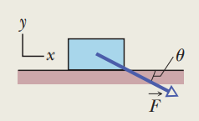
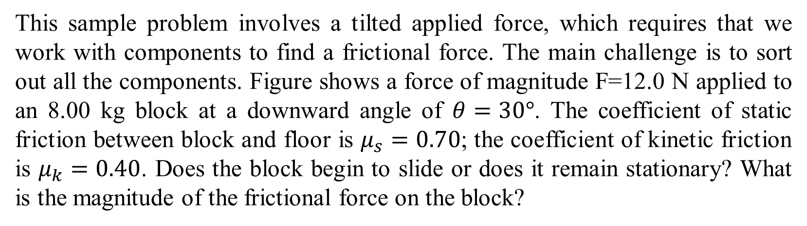
This sample problem involves a tilted applied force, which requires that we work with components to find a frictional force. The main challenge is to sort out all the components. Figure shows a force of magnitude F=12.0 N applied to an 8.00 kg block at a downward angle of $θ=30°$. The coefficient of static friction between block and floor is $μ_{s}=0.70$; the coefficient of kinetic friction is $μ_{k}=0.40$. Does the block begin to slide or does it remain stationary? What is the magnitude of the frictional force on the block?

Slide 2
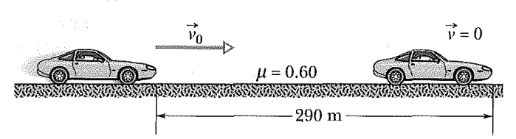
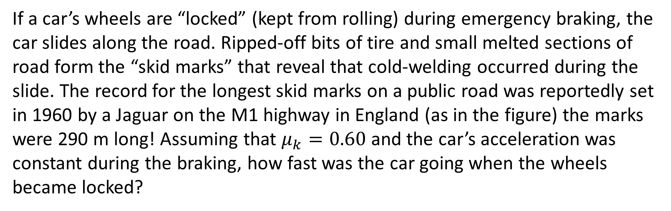
If a car’s wheels are “locked” (kept from rolling) during emergency braking, the car slides along the road. Ripped-off bits of tire and small melted sections of road form the “skid marks” that reveal that cold-welding occurred during the slide. The record for the longest skid marks on a public road was reportedly set in 1960 by a Jaguar on the M1 highway in England (as in the figure) the marks were 290 m long! Assuming that $μ_{k}=0.60$ and the car’s acceleration was constant during the braking, how fast was the car going when the wheels became locked?

Slide 3
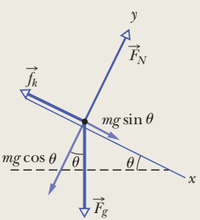
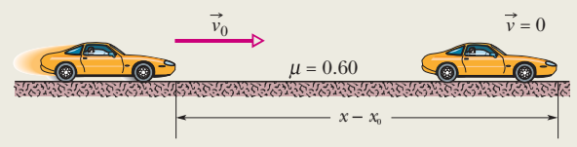
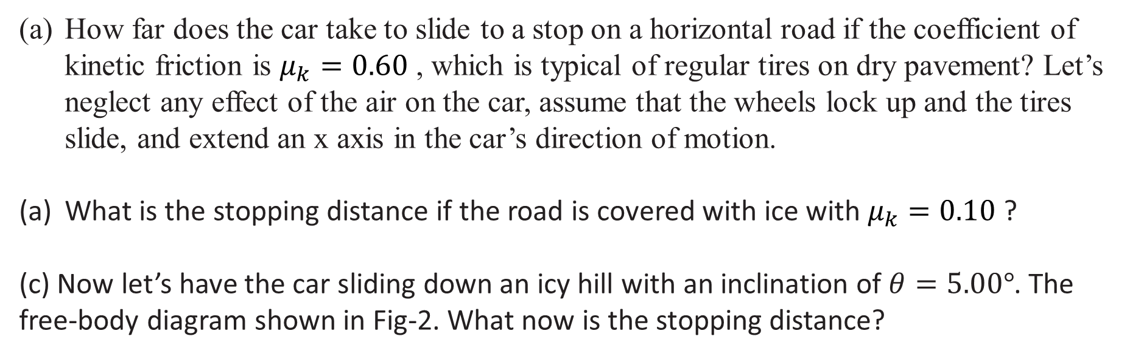
Some of the funniest videos on the web involve motorists sliding uncontrollably on icy roads. Here let’s compare the typical stopping distances for a car sliding to a stop from an initial speed of 10.0 m/s on a dry horizontal road, an icy horizontal road, and an icy hill.
How far does the car take to slide to a stop on a horizontal road if the coefficient of kinetic friction is $μ_{k}=0.60$ , which is typical of regular tires on dry pavement? Let’s neglect any effect of the air on the car, assume that the wheels lock up and the tires slide, and extend an x axis in the car’s direction of motion.
What is the stopping distance if the road is covered with ice with $μ_{k}=0.10$?
(c) Now let’s have the car sliding down an icy hill with an inclination of $θ=5.00°$. The free-body diagram shown in Fig-2. What now is the stopping distance?

Slide 4
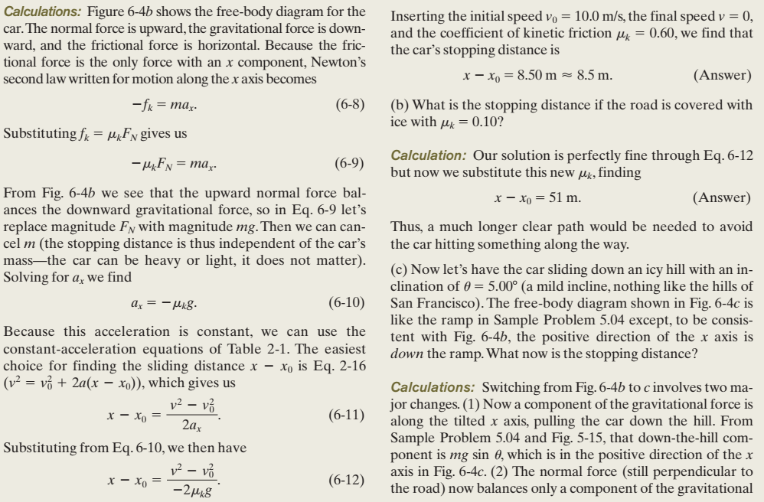

Slide 5
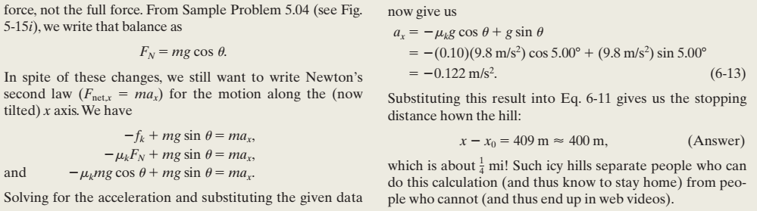

Slide 6
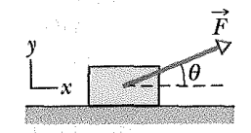
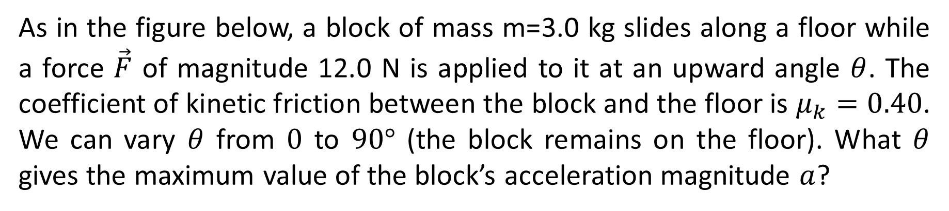
As in the figure below, a block of mass m=3.0 kg slides along a floor while a force $\vec{F}$ of magnitude 12.0 N is applied to it at an upward angle $θ$. The coefficient of kinetic friction between the block and the floor is $μ_{k}=0.40$. We can vary $θ$ from $0$ to $90°$ (the block remains on the floor). What $θ$ gives the maximum value of the block’s acceleration magnitude $a$?

Slide 7


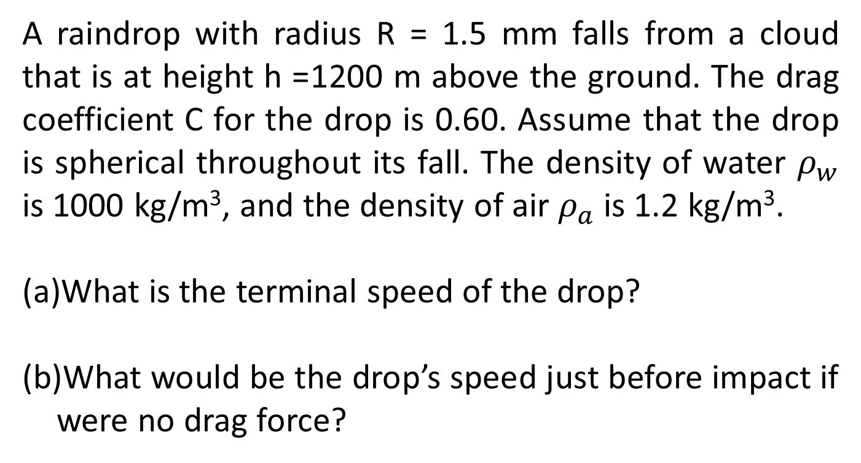
A raindrop with radius R = 1.5 mm falls from a cloud that is at height h =1200 m above the ground. The drag coefficient C for the drop is 0.60. Assume that the drop is spherical throughout its fall. The density of water $ρ_{w}$ is 1000 kg/m³, and the density of air $ρ_{a}$ is 1.2 kg/m³.
What is the terminal speed of the drop?
What would be the drop’s speed just before impact if were no drag force?

